Slide 1
Next-Level Skills for Early Childhood Educators
Session 5: Soft Skills
Notes:
V2: December 7, 2022

Slide 2

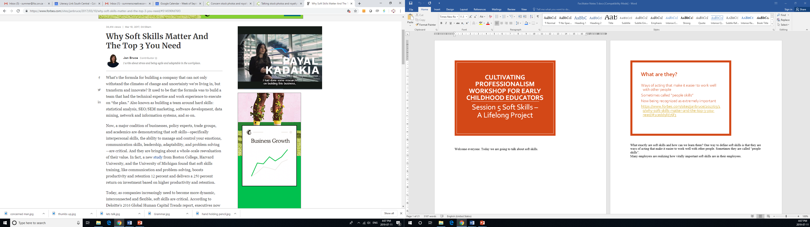
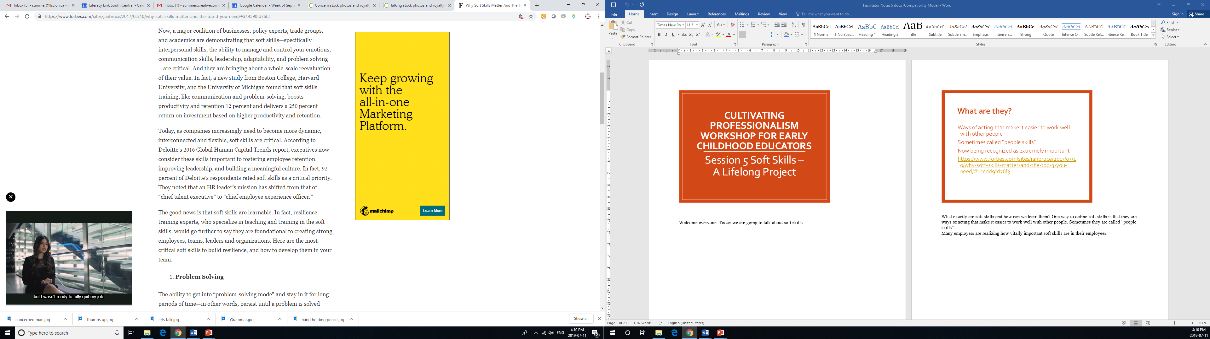
What are “Soft Skills”?
Ways of acting that make it easier to work well with other people
Sometimes called “people skills”
Now being recognized as extremely important
https://www.forbes.com/sites/janbruce/2017/03/10/why-soft-skills-matter-and-the-top-3-you-need/#1cedd9fd76f3

Slide 3
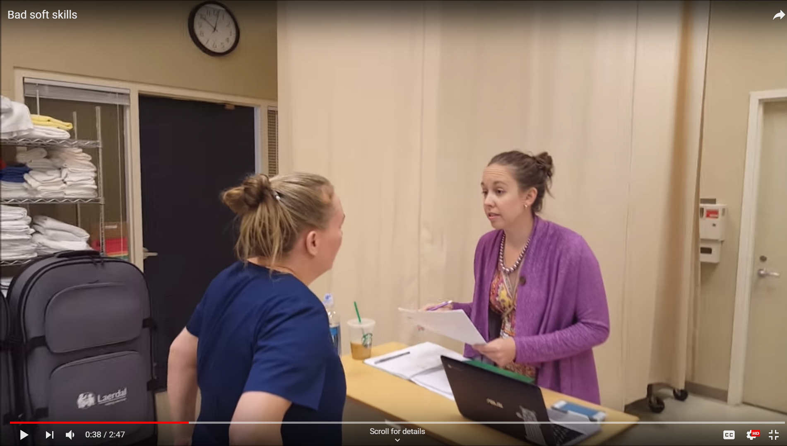
What happens when soft skills are lacking?
https://www.youtube.com/watch?v=xtpw9toisgk

Slide 4

Activity
How do you see yourself?
How do others see you?

Slide 5
Soft Skills for ECE’s
6
11
12
13
14
7
8
9
10
15/16
17
18
19
20
Notes:
Slide 6 Accountability, Slide 7 Adaptability, slide 8 Attitude, Slide 9 Critical thinking and problem solving, Slide 10 Strategic thinking, Slide 11 Influencing others, Slide 12 Leadership, Slide 13 Motivation, Slide 14 Presentation, Slides 15 & 16 Stress management, Slide 17 Mindfulness Exercises, Slide 18 Teamwork, Slide 19 Time management, Slide 20 Learning soft skills

Slide 6
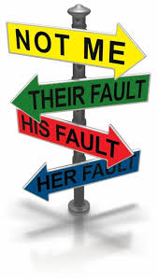
Accountability
Care about the quality of your work, own your actions both good and bad
Admit mistakes, take responsibility for them
Learn from them
Being accountable helps our relationships, our reputation, our career and our well-being
https://prezi.com/k7uf4okq1a4q/soft-skills-accountability/

Slide 7

Adaptability
Stay flexible when changes or new plans arise
Keep calm in the face of difficulties
Deal with changing priorities and workloads
Situations can change very rapidly when dealing with children, parents and other staff
Adaptability allows you to capitalize on the situation to teach new skills
Makes children feel heard, that they matter, when you adapt to situations as they occur

Slide 8
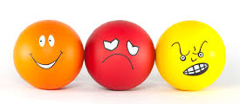
Attitude
You show your thoughts or feelings through your words and actions
It shows through in your tone and body language
You can read other people’s thoughts and feelings through their body language
Challenges to attitude
Strategies for getting back on track-recognize triggers, don’t take it out on others, remember role models, recognize small successes, continuous improvement
Attitude test
https://www.mindtools.com/pages/article/newTCS_89.htm

Slide 9
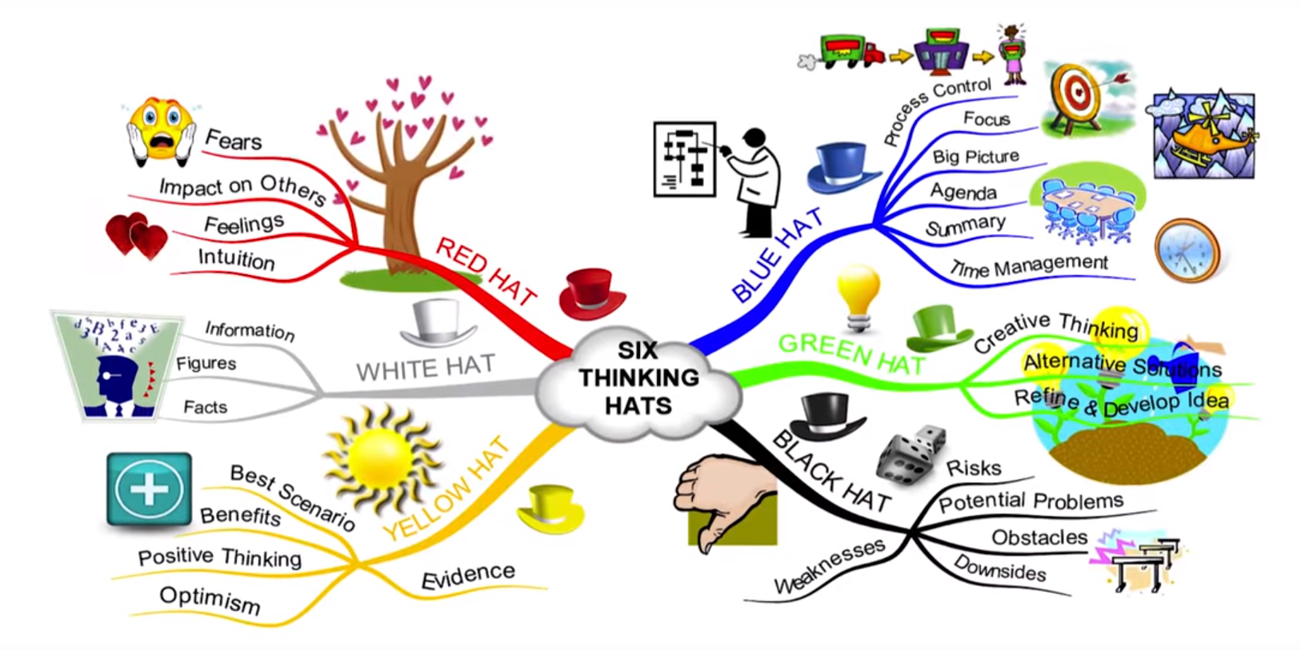
Critical Thinking and Problem Solving
Edward de Bono’s Six Thinking Hats https://www.youtube.com/watch?v=PASrBGtcrdU
We can also use the skills we teach children to take the emotion out of the situation:
Determine what the problem is
Think of a number of solutions
Pick one and try it
Did it work?

Slide 10

Strategic Thinking
Thinking creatively. How do you do this?
Be proactive and do things before you are asked to, prepare for the future
Develop an understanding of ideas that are opposing or different than yours. This gives you a more holistic view
Always look for ways to improve
Keep up to date on the latest news, studies

Slide 11
Influencing Others
Respect is key. No one likes to be told what to do. Motivational interviewing is a good technique
Listen to children, parents, other staff, give them some time to express themselves, ask open ended questions
Affirmation of their desire, of themselves, their solutions or next steps
Reflect back to them to clarify or check understanding
Summarize problem and steps to take
As a professional child-care worker you are being a role model for the children at all times, for parents

Slide 12

Motivation
Wanting to do something really well
Driven to achieve
Showing commitment
Demonstrating initiative
Being optimistic
Connected to values
When you have setbacks, think about your values and plan and why it is important. Talk to someone in your support network, give yourself a visual reminder, and learn from those setbacks.

Slide 13

Presentation
The way you look and sound
to others, including:
Dress
Hygiene
Language
Manners
What is appropriate can change depending on who we are talking to, the situation we are in, or cultural differences.

Slide 14

Stress Management
Holmes-Rahe Life Stress Inventory: https://www.talent.wisc.edu/Home/Portals/0/OPC/2009/Letting%20Go%20of%20Stress.pdf
We all experience at times. How can it be dealt with in a constructive way?
Recognize the signs of stress within ourselves and deal with them, rather than taking it out on children, parents other staff, etc.
Notes:
Handout-Holmes-Rahe Life Stress Inventory

Slide 15
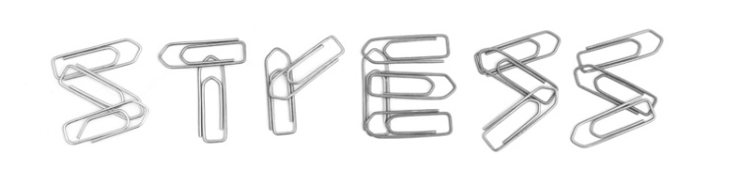
Stress Management
Signs of stress:
headaches, aches and pains, frequent sickness, fatigue and insomnia, digestive issues, changes in appetite, depression, rapid heartbeat, sweating, loss of libido. Be aware of your signs.
Self-care methods to reduce stress:
Exercise, yoga, essential oils, mindfulness practice, supplements, reduce caffeine, keep a gratitude journal, chew gum, spend time with friends and family, laugh, learn to say no, avoid procrastination, cuddle, listen to relaxing music, deep breathing, spend time with pet.
Notes:
Handout-Holmes-Rahe Life Stress Inventory

Slide 16
Activity
Mindfulness Exercises:
https://positivepsychologyprogram.com/mindfulness-exercises-techniques-activities/
https://positivepsychology.com/mindful-self-compassion/
Notes:
Choose a mindfulness exercise that would be well accepted by your group. Some suggestions are from these websites: https://positivepsychologyprogram.com/mindfulness-exercises-techniques-activities/
https://positivepsychology.com/mindful-self-compassion/

Slide 17

Teamwork
Take responsibility for finishing your work
Cooperate with others, help them get their job done
Think about the whole team’s job, not just your own part
Treat others with respect
Try to solve the problems rather than placing blame
Involves trust
Resolving conflicts
Requires all kinds of people
Notes:
Possible activity-Headbandz game. Eleven commandments for an enthusiastic team-handout.

Slide 18

Time Management
Making decisions about how you spend your time:
At home and at work
Prioritizing: what is the most important?
Being productive
Avoid procrastinating: make a start, ask for advice, break it into smaller steps, create deadlines for each step, get rid of distractions, and reward yourself for success
Planning your time = accomplishing your goals!

Slide 19

Learning Soft Skills
Do people either have them… or not?
Can they be developed?
What is the best way to develop them?
Think of a person who has
good soft skills. Describe the
situation in which they
demonstrated their skills.
How can soft skills be taught to children?
SKILLS

Slide 20
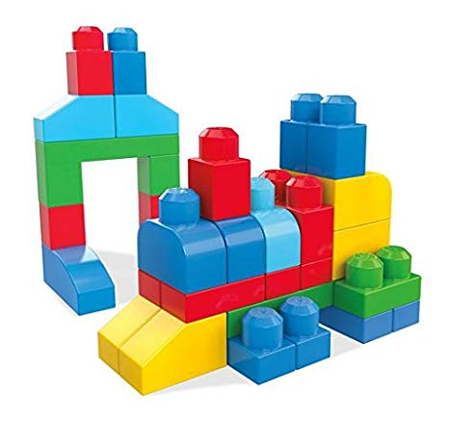
Activity: Mega Bloks in Pairs

Slide 21

Journal Reflection
Who are your role models?
What have you learned from them?
What do you hope to learn?
Notes:
Facilitator note: You do not need to advance to the next screen for the group – it is for identification purposes only.

Slide 22


Acknowledgements:
This presentation was designed in 2019 to support Ontario’s Early Childhood Educators in further developing the unique communication skills required in their role. It should be used with the accompanying Participant Workbook, and Reflection Journal.
Curriculum developed by: Carolyn Little and Helen Krygsman
Editing and design support by: Summer Burton
Support for this project was provided by:
Organizations are encouraged to copy and use these materials; however, reproducing or reselling these materials for profit is prohibited. If you have questions about this curriculum, we invite you to contact Literacy Link South Central at 519-681-7307 or literacylink@llsc.on.ca

Slide 23
Sources
Are You a Positive or Negative Thinker? (n.d.). Retrieved from https://www.mindtools.com/pages/article/newTCS_89.htm
Bruce, J. (2017, March 10). Why Soft Skills Matter And The Top 3 You Need. Retrieved from https://www.forbes.com/sites/janbruce/2017/03/10/why-soft-skills-matter-and-the-top-3-you-need/#1cedd9fd76f3
DOSE, B. (2018, August 25). Retrieved March 06, 2019, from https://www.youtube.com/watch?v=PASrBGtcrdU
Heiman, M. (2016, July 29). Bad soft skills. Retrieved from https://www.youtube.com/watch?v=xtpw9toisgk
LaRo, G. (2016, December 15). Soft Skills: Accountability. Retrieved from https://prezi.com/k7uf4okq1a4q/soft-skills-accountability/
The Empathy Toy. (n.d.). Retrieved from https://twentyonetoys.ca/pages/empathy-toy
The Holmes and Rahe Stress Scale Understanding the Impact of Long-term Stress. (n.d.). Retrieved from https://www.mindtools.com/pages/article/newTCS_82.htm

